Slide 1
SUPPLY CHAIN RISK AND CUSTOMER RETENTION ANALYSIS

Slide 2
INTRODUCTION
What is a Supply Chain?
A supply chain is the complete process of moving a product from the manufacturer to the customer. It involves activities such as production, transportation, warehousing, and delivery.
Why is Shipment Delay Important?
Late deliveries reduce customer satisfaction . Delays increase transportation and operational costs . Businesses need to identify delivery risks to improve efficiency.
Project Goal :
This project analyzes shipment data to identify delivery delays, classify shipment risks, and generate business insights using data analytics and visualization techniques.

Slide 3
Problem Statement & Objectives
Problem Statement :
Supply chain data is available in large amounts.
It is difficult to identify supply chain risks in the data.
Delivery performance problems, especially late delivery, need to be analyzed.
Business sales and profit performance are difficult to understand from raw data.
Customer purchasing and repeat-order behavior are not clearly visible.
A data-driven dashboard is needed to identify supply chain risks and customer retention opportunities.

Slide 4
PROJECT OBJECTIVES
Project Objectives Analyze shipment and sales data.
Identify delayed and on-time deliveries.
Calculate shipment delay days.
Classify shipments into different risk levels.
Analyze sales by category and month.
Generate visual insights to support better business decisions.

Slide 5
Dataset Overview
Dataset Overview :
The project uses a Supply Chain Shipment Dataset containing information about customer orders, shipping details, product information, and sales.
This dataset is used to analyze shipment delays, delivery risks, and sales performance.
Dataset Information
Total Records: 5,000
Total Features (Columns): 31
Data Types: Integer, Float, Object, and Datetime
Dataset Type: Structured Data (CSV)

Slide 6
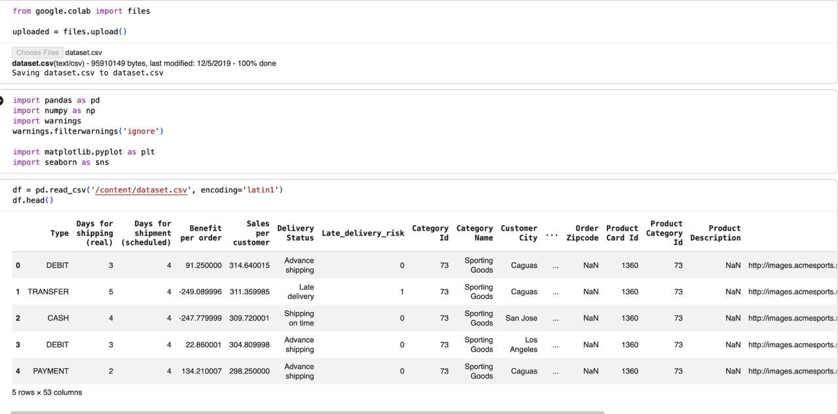
Data collection

Slide 7
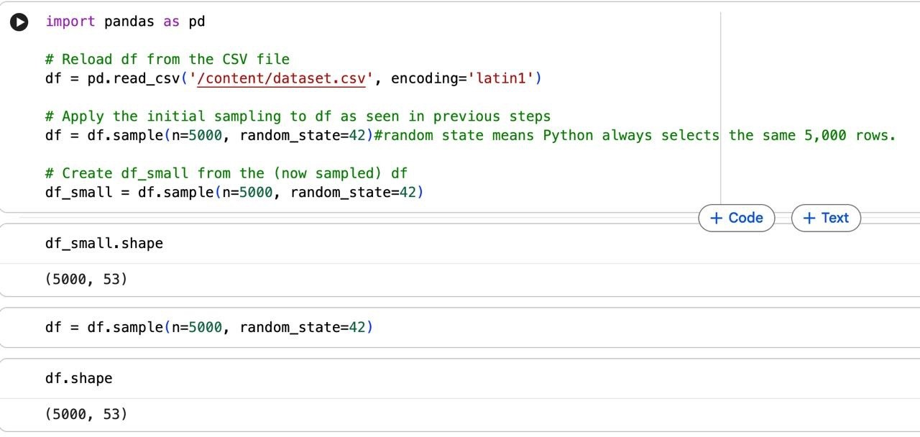
Data Reduction

Slide 8
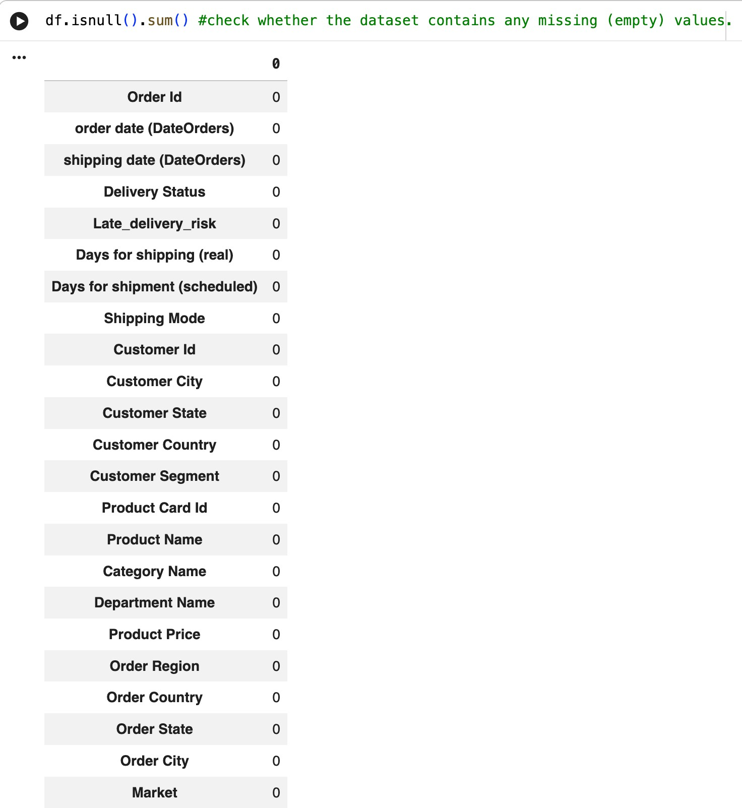

DATA PREPROCESSING AND DATA CLEANING
Data Preprocessing :
Data preprocessing is the process of cleaning and transforming raw data into a structured and usable format for accurate analysis.
Data Cleaning:
Data cleaning is the process of identifying and correcting missing, duplicate, or inconsistent data to improve data quality.

Slide 9
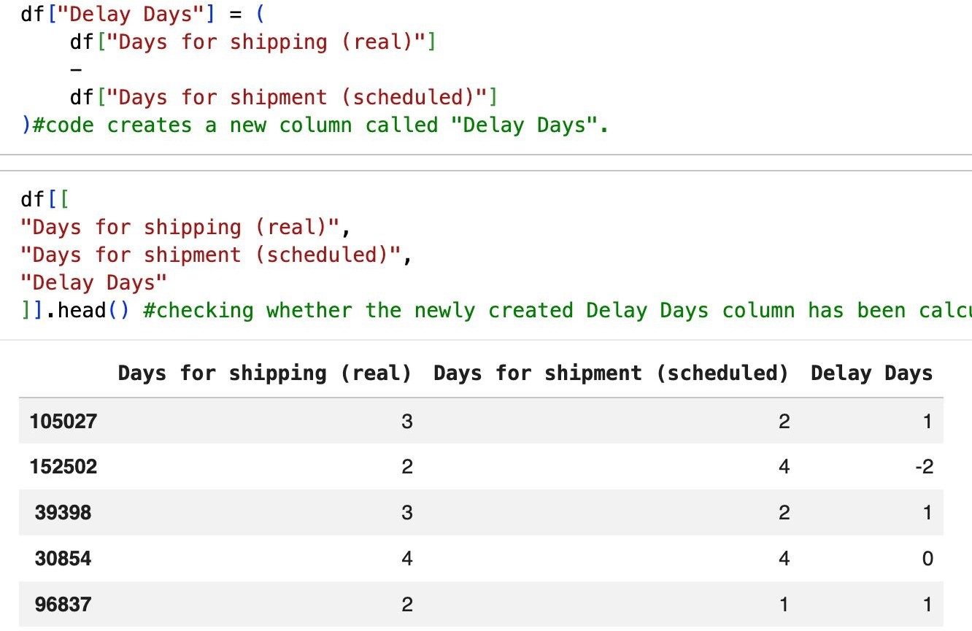
Feature Engineering
Feature Engineering is the process of creating new features (columns) from existing data to improve analysis and generate meaningful insights.

Slide 10
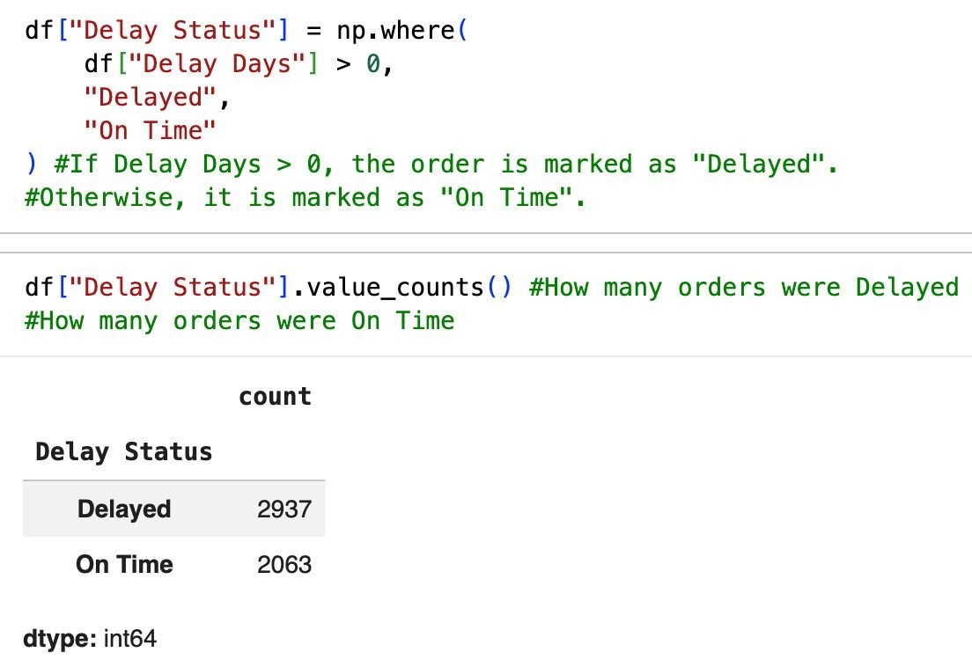
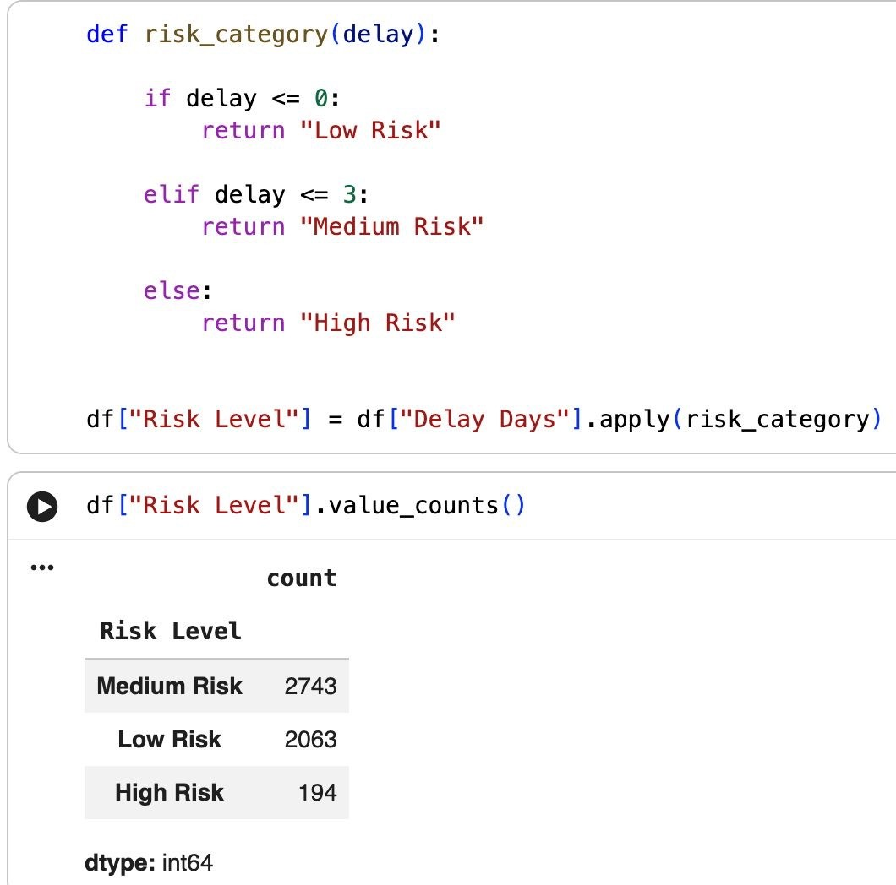

Slide 11
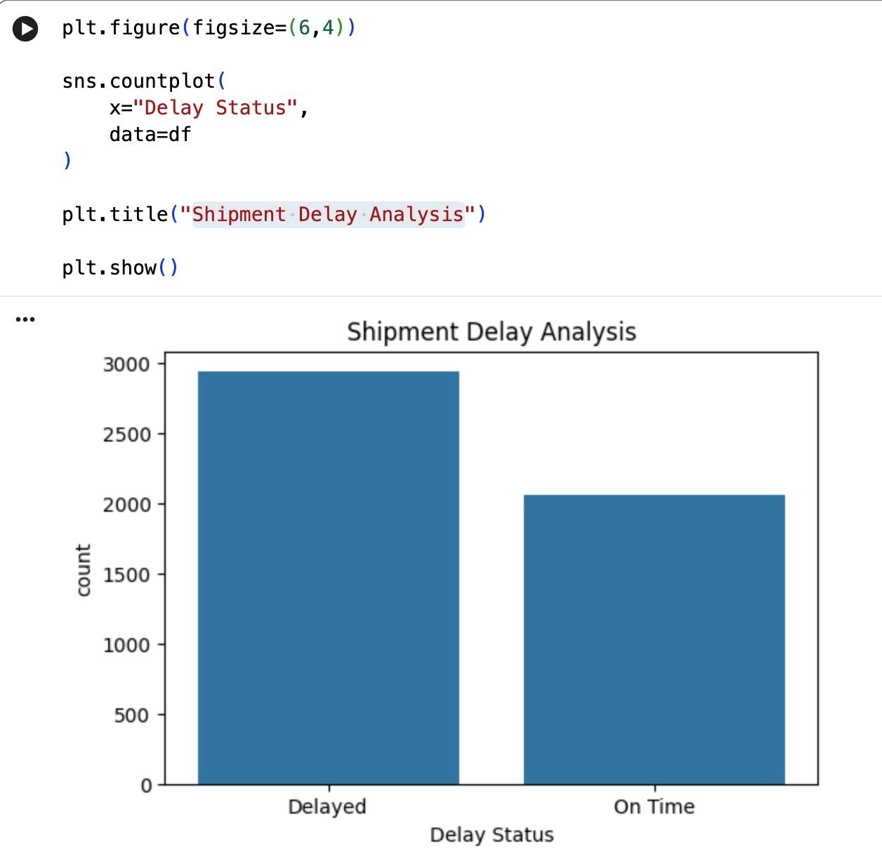
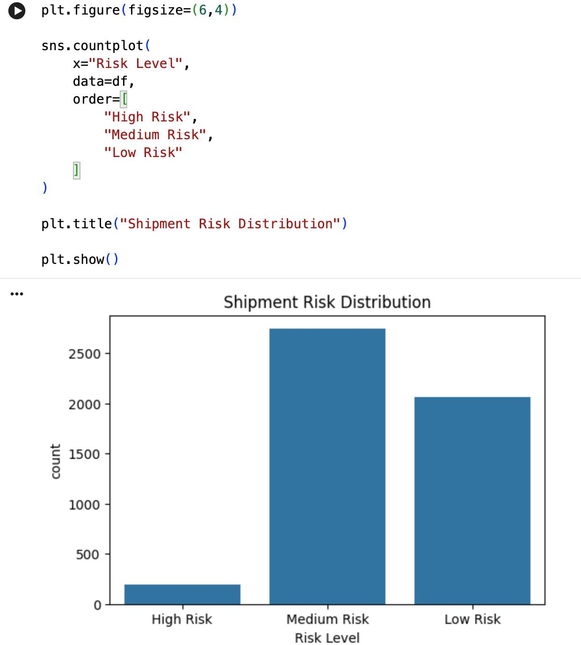
Exploratory Data Analysis (EDA)
Shipment Delay Analysis Shipment Risk Distribution

Slide 12
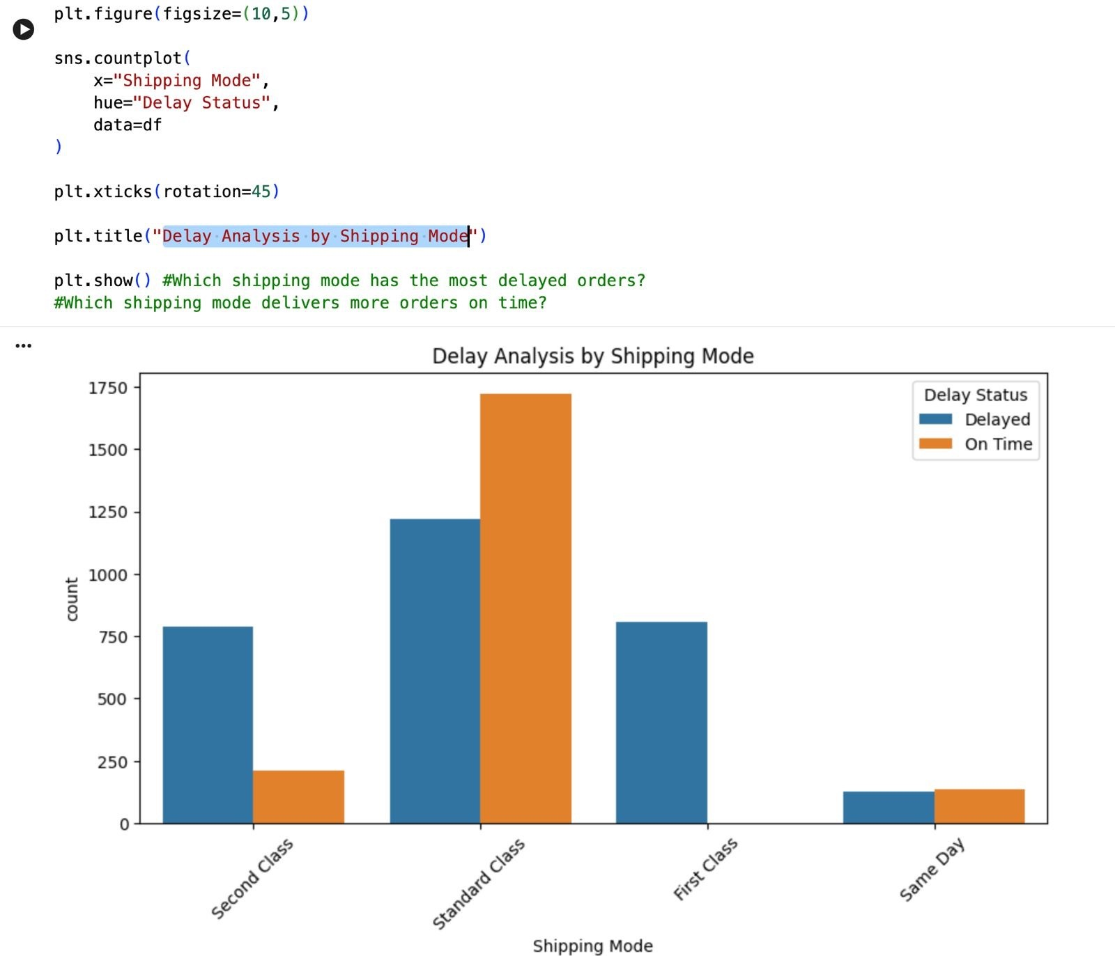
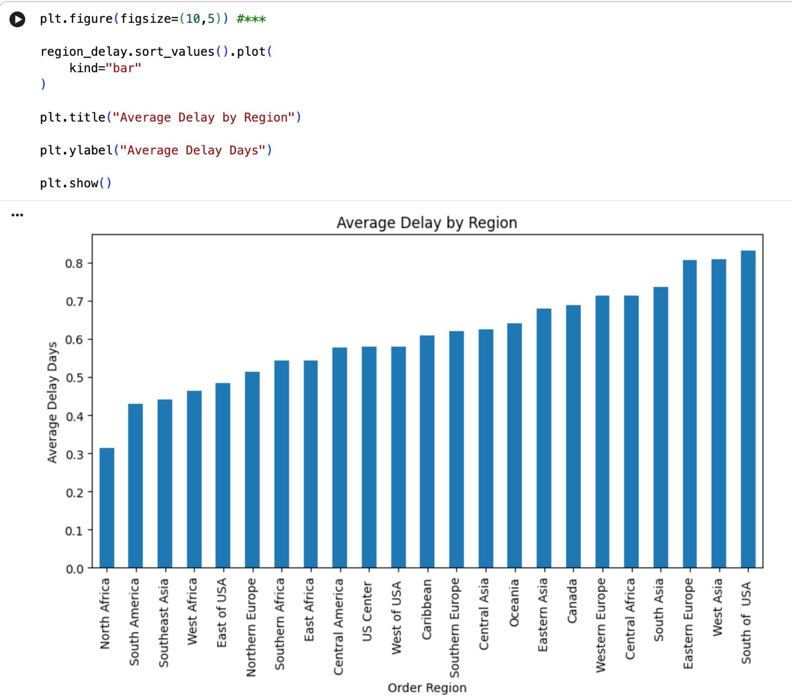
Exploratory Data Analysis (EDA)
Delay Analysis by Shipping Mode Average Delay by region

Slide 13
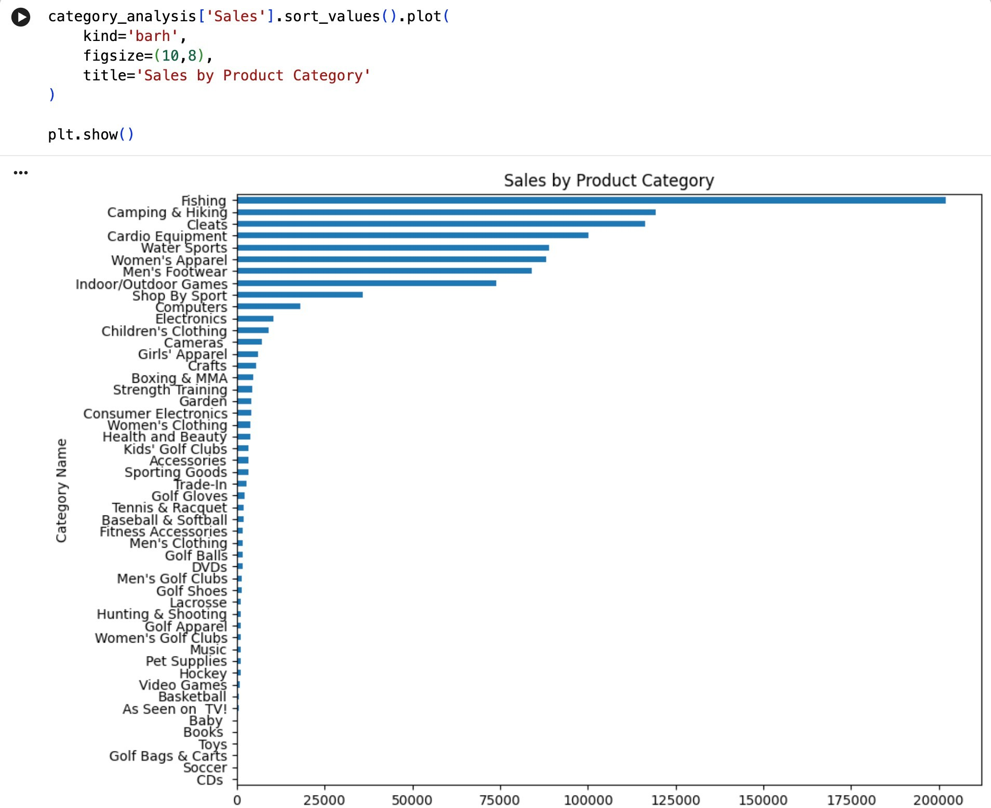
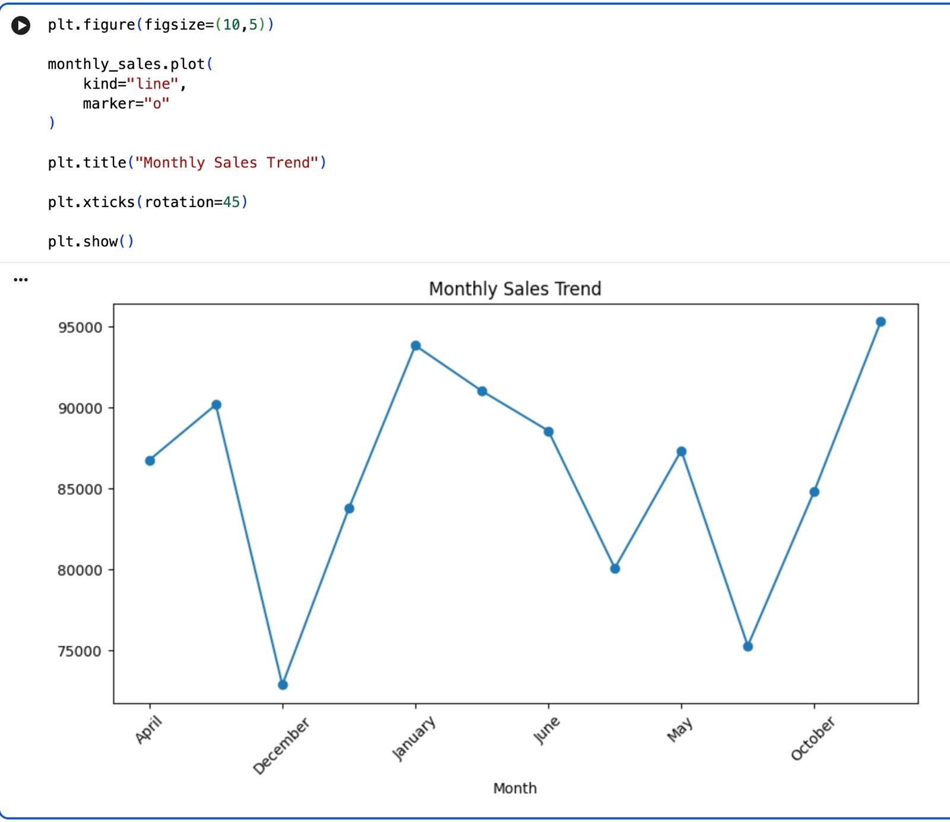
Exploratory Data Analysis (EDA)
Monthly Sales trend Sales by Product Category

Slide 14
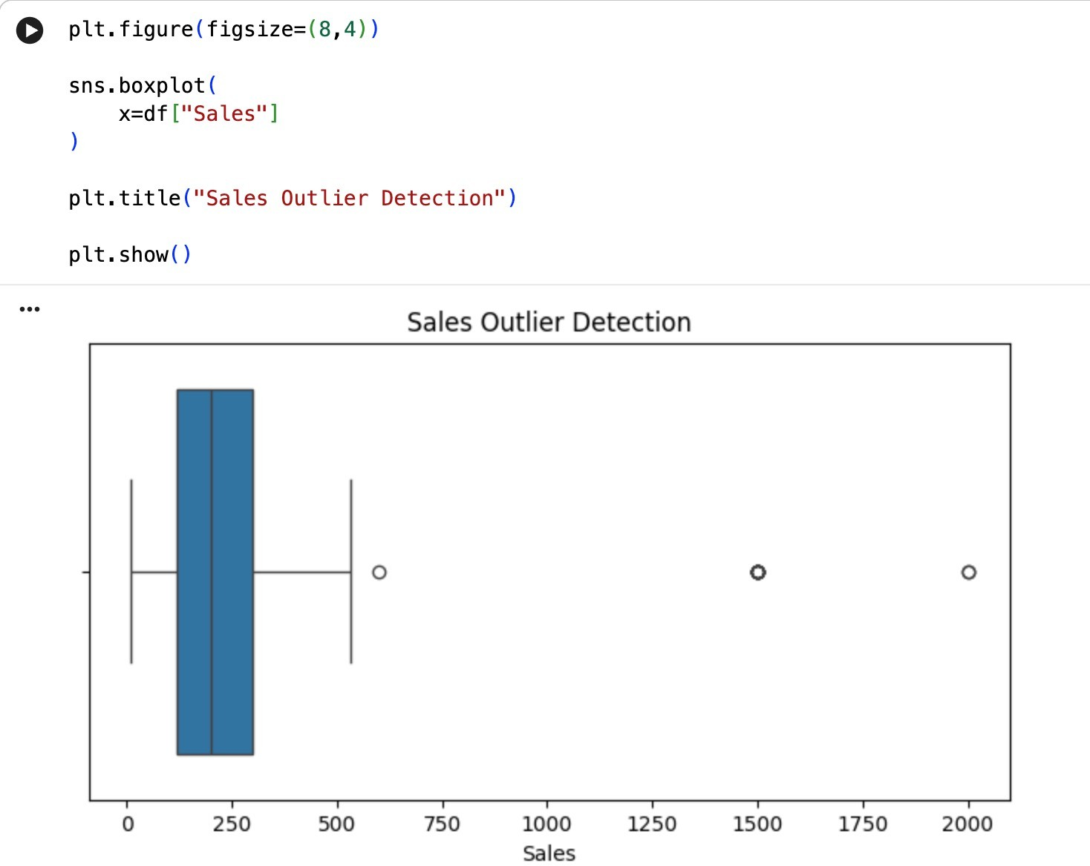
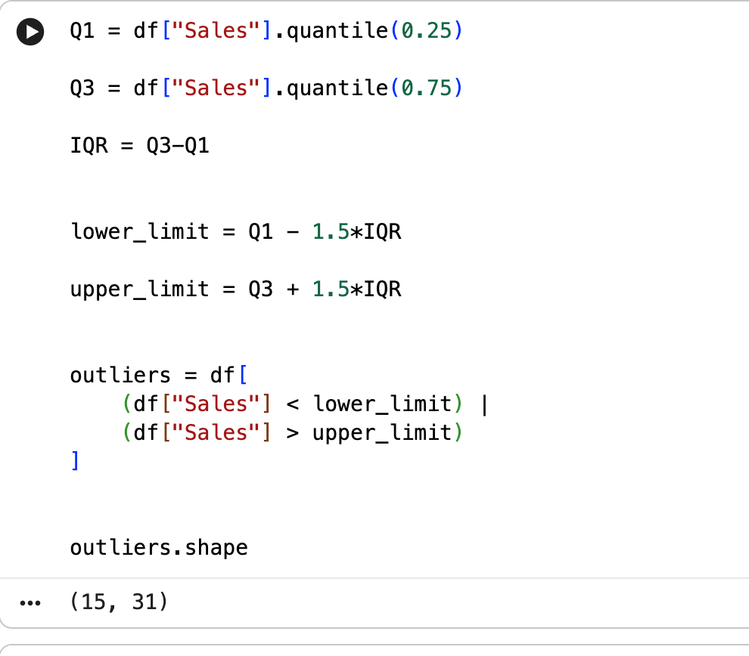
Outliers

Slide 15
Business Insights
More than half of the shipments were delayed, indicating a need to improve delivery planning and logistics operations.
Standard Class shipping handled the highest number of orders, but it also experienced the largest share of delivery delays.
Medium-risk shipments formed the largest risk category, suggesting that improving operational efficiency could significantly reduce delays.
Sales were concentrated in a few product categories, while some categories generated low revenue and may require promotional strategies
or inventory review.
Monthly sales showed noticeable fluctuations, indicating seasonal demand patterns that should be considered for inventory
and workforce planning.
Certain regions experienced higher average delivery delays, highlighting the need to optimize transportation routes
and regional distribution centers.
Order discounts helped increase sales volume, but excessive discounts may reduce overall profit margins.
Most outliers were associated with high-value orders, requiring additional monitoring to minimize financial and operational risks.

Slide 16
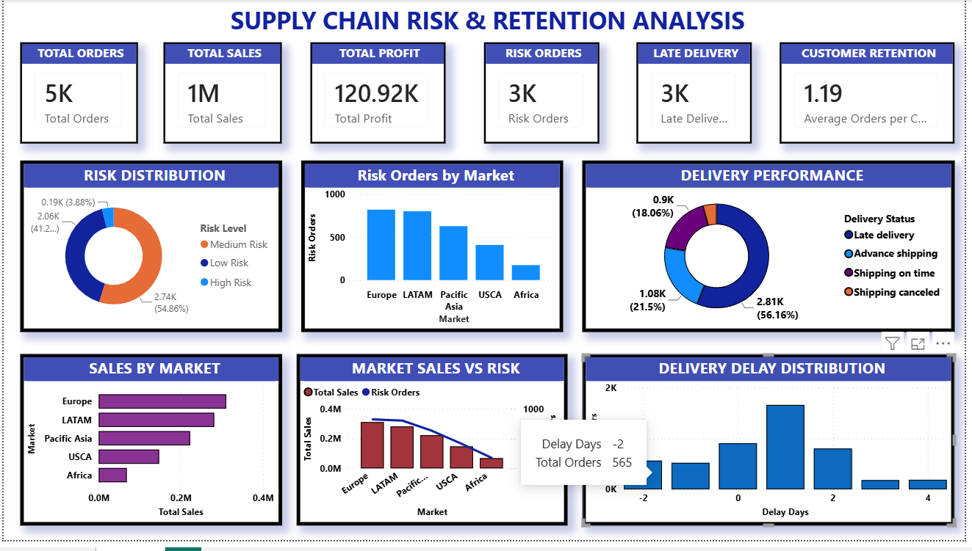

Slide 17
Conclusion
This project successfully analyzed supply chain shipment data to identify delivery delays, classify shipment risks, and evaluate sales performance. Through data preprocessing, feature engineering, and exploratory data analysis, meaningful business insights were generated.
The analysis highlighted shipment delay patterns, regional delivery performance, sales trends, and outlier transactions. These insights can help businesses improve logistics, optimize delivery operations, and support better decision-making.
Overall, this project demonstrates how Data Analytics can transform raw supply chain data into valuable business insights that improve operational efficiency and customer satisfaction

